Slide 1


Design of an FPGA based patient history tracking, monitoring and Diagnostic support system
Review-2
AY 2025-26
Capstone Project – Introduction (PROJ2999)
GITAM (Deemed-to-be) University
Department of Electrical Electronics and Communication Engineering
Project Team:
Madicharla Vishnu Teja
Harshit Ramesh Hundia
Darshan . H
Project Mentor:
Dr. Ajit Kumar
Project In-charge:
Dr. Jaya Prakash Sahoo
www.gitam.edu

Slide 2
Objective and Goals
Objective
The objective of this project is to design and implement a real-time FPGA-based system that efficiently tracks and manages patient medical histories, including surgeries, tests, and treatments. The system aims to provide continuous monitoring and diagnostic support by integrating medical data with rapid hardware processing capabilities. Additionally, it plans to incorporate external sensor interfaces to detect vital signs such as temperature and heart rate, continuously update patient records, and generate alerts for any abnormalities to enhance timely medical intervention. This project combines high-speed data handling with healthcare management to improve accuracy, accessibility, and responsiveness in patient monitoring and diagnostics.
Goals
Main Goals
Design and develop an FPGA-based system for tracking patient medical history.
Store and update records of patient procedures, operations, and test results accurately.
Enable real-time monitoring and retrieval of patient historical data.
Provide diagnostic support for healthcare professionals using fast hardware processing.
Ensure reliable, secure storage and communication of patient information
Additional Goals
Integrate external sensor circuits for automatic acquisition of vital signs (e.g., temperature, heart rate).
Continuously update medical history with real-time physiological data.
Implement an alert system to notify abnormalities for prompt clinical response.

Slide 3
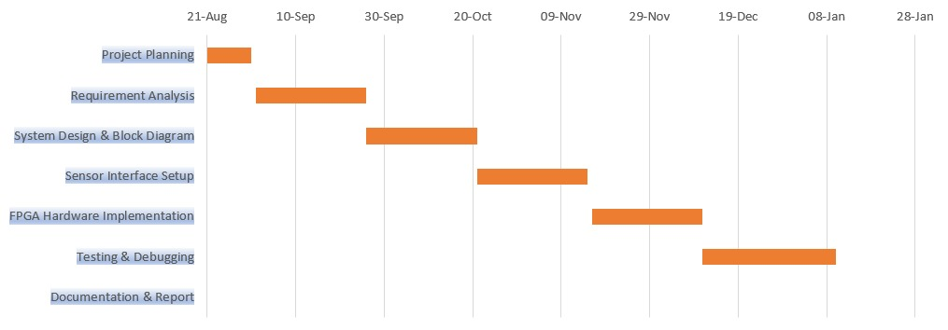
Project Plan

Slide 4
Literature Survey
Key Publications and Resources
1. Health Monitoring and Jaundice Detection System Using Verilog
Author: Nandana Murali, Rajesh Kannan Megalingam, Chebrolu Gowtham
Source: IEEE Xplore
Key takeaways: The Verilog code implemented a health monitoring and jaundice detection system. The system outputs the abnormality in heart and blood pressure rates and also predicts the presence of Jaundice. If the abnormality in vitals is continuous for three counts, then an alert is generated
2. Design and Implementation of Smart Healthcare Monitoring System Using FPGA
Author: Prem Kumar Badiganti, Sumanth Peddirsi, Alla Tirumala Jagannadha Rupesh, and Suman Lata Tripathi
Source : Google scholar
Key takeaways: Heart rate, temperature , BP and ECG are health parameters considered. The data is measured from the patient using specialized medical sensors which are to be interfaced with an FPGA board.
3. Design of Health Monitoring System using FPGA
Author: Anjali Chindham, Donthagani Rakesh, Sabavath Virisha, Racha Ganesh
Source : Google scholar
Key takeaways: The patient’s health vitals are considered as the input parameters and the patients health status is displayed on the FPGA board in the form of 0’s and 1’s.
4. FPGA-Based Smart Health Monitoring Systems for Wearable Devices
Author: Muthukumaran Vaithianathan, Shivakumar Udkar, Manjunath Reddy, Deepanjan Roy, Senkadir Rajasekaran
Source : Google scholar
Key takeaways: By combining FPGA computing with cutting-edge sensor technology, intelligent health monitoring systems employ FPGA. Photoplethysmography (PPG) sensors quantify heart rate, while accelerometers document motion, among numerous other physiological attributes assessed by the extensive sensor networks of these systems.

Slide 5
Literature Survey
5. FPGA-Based System for Countinous Monitoring of Three Vital Signs of Human Body
Author: Aminuddin Rizal*, Munawar A Riyadi, Darjat
Source: IEEE Xplore
Key takeaways: This paper is mainly used to track heart conditions, respiratory system and body conditions by monitoring age, heart rate, breathe rate and body temperature. All the data that is tracked by various sensors are integrated into the system to process of health data. Health report and Health status as outputs where health report contains Body temperature conditions,Heart conditions and Respiratory conditions. The paper presents a low-cost FPGA-based system that continuously measures three vital signs—temperature, heart rate, and respiratory rate—using simple non-invasive sensors with good accuracy, making it suitable for affordable patient monitoring.
6. Monitoring Temperature in FPGA based SoCs
Author: Siva Velusamy , Wei Huang , John Lach, Mircea Stan,and Kevin Skadron
Source: IEEE Xplore
Key takeaways: The paper demonstrates an FPGA-based system that accurately monitors on-chip temperatures using ring-oscillator sensors, validates these readings against HotSpot simulations, and shows that effective dynamic thermal management can reduce local hotspots by intelligently distributing high-power blocks.
Existing Implementations:
https://github.com/anik187/FPGA_BASED_HEALTH_MONITORING_SYSTEM

Slide 6
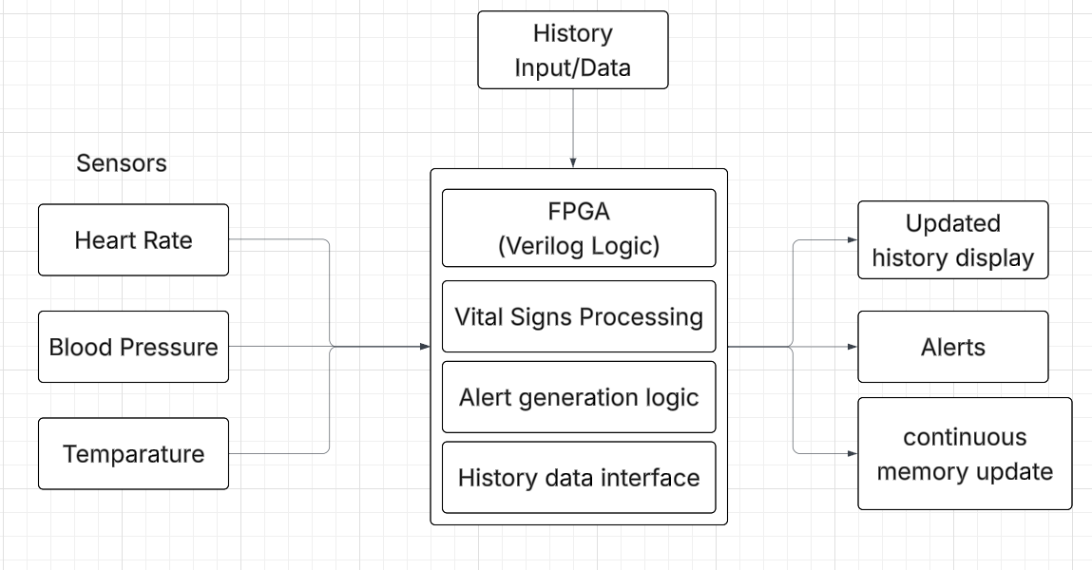
Architecture
Structural Diagram

Slide 7
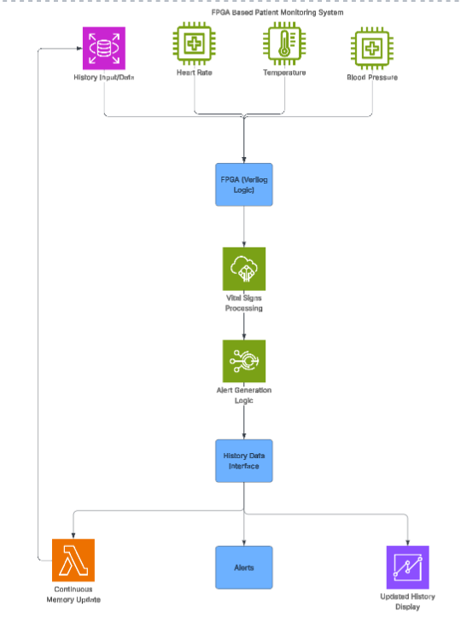
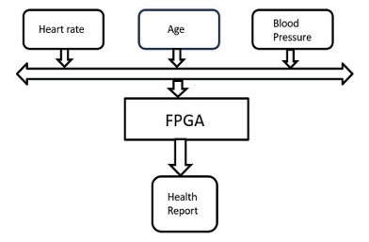
Architecture
Flow chart

Slide 8
Use Cases & Testing
Use Cases
Continuous Monitoring: The system continuously acquires and monitors vital signs (heart rate, blood pressure, temperature) of a patient in real-time.
Abnormal Vital Alert: Automatically detects abnormal vital signs (e.g., high blood pressure) and generates alerts for immediate attention.
Patient History Management: Stores and retrieves comprehensive patient medical history including past treatments and health reports for doctor reference.
Doctor Notification: Sends alerts and real-time patient data to the attending doctor or healthcare staff for timely intervention.
Data Logging: Maintains logs of all monitored health parameters with timestamps for review and analysis.
Remote Monitoring: Enables remote access to patient vitals and history, allowing monitoring from different locations (future implementation).
Multi-Patient Monitoring: Supports monitoring multiple patients simultaneously in hospital or home-care settings (future scope).
Test Cases
Sensor Data Accuracy Test: Validate that heart rate, blood pressure, and temperature sensors output accurate readings compared to standard devices.
Alert Generation Test: Test the system’s ability to trigger alerts when vitals cross predefined threshold limits.
Data Storage Test: Verify patient history data is correctly saved, updated, and retrieved from the memory without loss or corruption.
System Response Time Test: Measure the time taken to process sensor data and generate alerts to ensure real-time performance.
Fault Tolerance Test: Check system behavior when one or more sensors fail or provide faulty readings.
Power Failure Test: Assess system recovery and data integrity after sudden power interruptions.
Boundary Condition Test: Test system performance with minimum and maximum expected vital sign values.

Slide 9
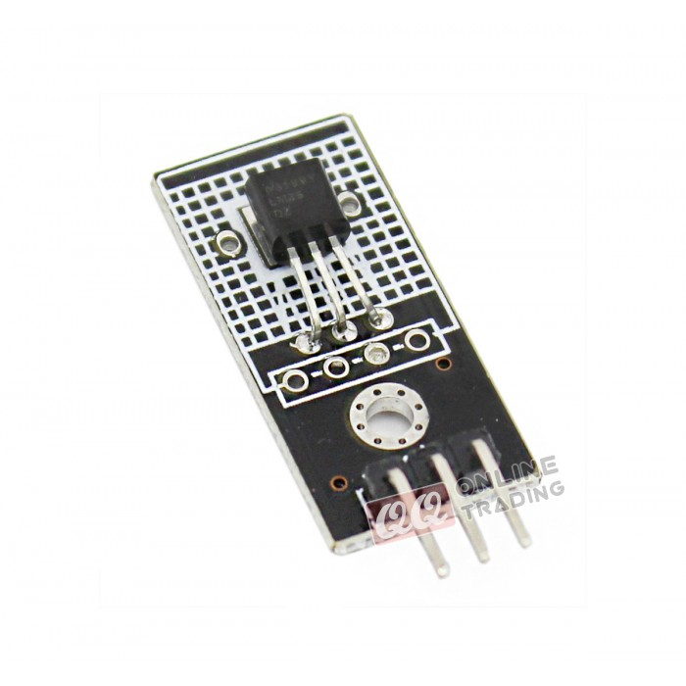
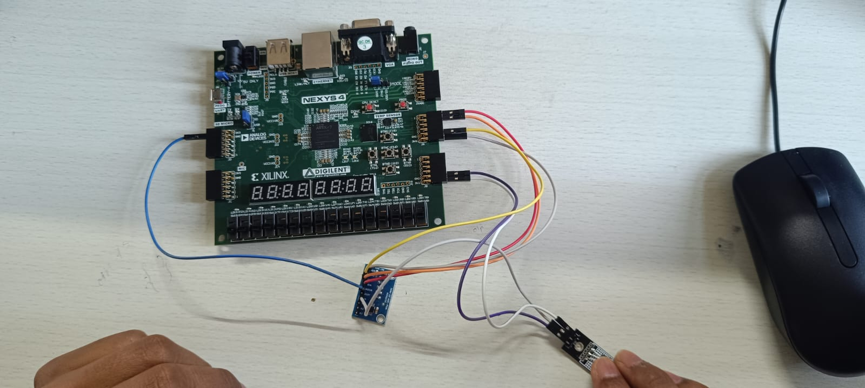
Implementation and Results – Iteration 1
Iteration 1 :
We have implemented the LM35 temperature sensor module and successfully interfaced it with the FPGA through the ADC. The sensor output is being read correctly, and our Verilog code accurately converts the ADC values into temperature readings in degrees Celsius. Initially, we faced issues such as noise spikes and timing mismatches, but these were resolved by adding proper synchronization and refining the sampling logic. At present, we are making small improvements to ensure continuous and noise-free real-time temperature readings. With the temperature module completed, we are now moving ahead to interface the remaining vital sensors, including the heart rate sensor and respiratory rate sensor. The heart rate sensor will be connected using our I²C communication module, and we will extract heart rate values using peak detection techniques, while the respiratory rate sensor will be connected through the ADC, allowing us to process the waveform and calculate breaths per minute. Once these modules are developed, all sensor readings will be integrated in the top-level FPGA design and displayed through UART, OLED, or 7-segment output. Overall, our implementation is progressing well, and the successful results of the LM35 module validate the accuracy and reliability of our system.

Slide 10
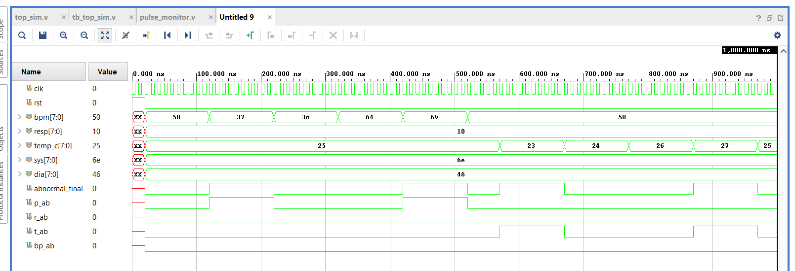
Simulation Output - Vivado

Slide 11
Conclusion & Future Work
Summary and Conclusion
The FPGA-based patient history tracking and monitoring system provides continuous real-time monitoring of vital parameters such as heart rate, blood pressure, and temperature.
The system facilitates efficient storage and retrieval of patient history, including treatment details and health reports, enabling better diagnosis and care.
Alerts are generated promptly when abnormal vital signs are detected, ensuring timely intervention.
Implementation on FPGA allows for fast processing, low latency, and reliable performance compared to microcontroller-based systems.
The design was tested for different abnormal conditions and successfully generates accurate health status reports for patients.
This system reduces the need for constant manual monitoring and supports remote healthcare.
Future Work
Integration of additional sensors for monitoring more health parameters like oxygen saturation (SpO2), respiratory rate, and ECG signals.
Incorporation of machine learning algorithms on FPGA for predictive health analysis and early disease detection.
Enhancing the system with wireless IoT connectivity for remote access and real-time cloud data synchronization.
Development of a mobile or web app interface for doctors and caregivers to monitor multiple patients simultaneously.
Extension of patient history management with comprehensive electronic health records (EHR) and support for multi-user access.
Implementation of advanced alert systems with automated emergency response notifications.

Slide 12
THANK YOU
Have a Great Day !

